Slide 1
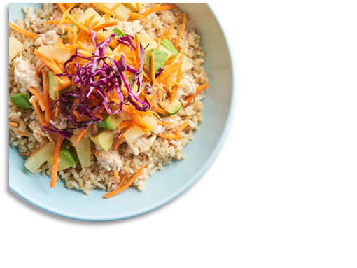
District Logo
May 2025
CAM HIGH SCHOOL
MENU
Semester Exams
21 & 22 May
 | MON |  | TUES |  | WED |  | THURS |  | FRI
 |  |  |  |  |  | 1 |  | 2
5 |  | 6 |  | 7 |  | 8 |  | 9
12 |  | 13 |  | 14 |  | 15 |  | 16
19 |  | 20 |  | 21 |  | 22 |  | 23
26 |  | 27 |  | 28 |  | 29 |  | 30
Chicken & Cheese Biscuit
A. French Toast Sticks w/ Sausage Patty
B. Grilled Chicken SDW
C. Meat Lovers Pizza
Sausage & Cheese Biscuit
A. Italian Dunkers
B. Tater Tot Beef Nachos
C. Variety Pizza
Ham, Egg & Cheese Muffin
Mini Corn Dogs
B. Bosco Sticks
C. Cheese or Pepperoni Pizza
French Toast
A. Beef Nachos
B. Chicken Nuggets
C. Cheese or Pepperoni Pizza
Homemade Breakfast Pizza
A. Country Popcorn Chicken Potato Bowl
B. McRibb
C. Sausage Pizza
Egg & Cheese Bagel Melt
A. Pancakes w/ Egg Patty
B. Chicken Tenders
C. BBQ Chicken Pizza
Sausage & Cheese Biscuit
A. Lasagna
B. Corn Dog
C. Variety Pizza
Offered Daily @ Breakfast
Fresh Fruit
1% White Milk
Chocolate Milk
100% Fruit Juice
Assorted Cereals w/ Graham Crackers
Egg & Cheese English Muffin Melt
A. Pretzel w/ Cheese Sauce
B. Popcorn Chicken
C. Cheese or Pepperoni Pizza
Country Sausage Gravy w/ Biscuit
A. Bosco Sticks w/ Sauce
B. Fish Filet
C. Cheese or Pepperoni Pizza
Homemade Breakfast Pizza
A. BBQ Rib
B. Chicken Tenders
C. Sausage Pizza
Sausage & Cheese Bagel Melt
A. Donut w/ Egg Patty
B. Pulled Pork SDW
C. Meat Lovers Pizza
Ham, Egg & Cheese Muffin
A. Mac & Cheese
B. Sloppy Joe
C. Variety Pizza
Offered Daily @ Lunch
1% White Milk
Chocolate Milk
Cheese & Pepperoni Pizza
Cheeseburger
Chicken Sandwich
Spicy Chicken Sandwich
Sun Butter & Jelly Sandwich
Salad and Deli Sandwich options
Tots or Fries
Variety Breakfast
A. Fish Sticks
B. Corn Dog
C. Cheese or Pepperoni Pizza
Variety Breakfast
A. Chef’s Choice
B Variety Pizza
Variety Breakfast
A. Chicken Sandwich
B. Cheeseburger
C. Variety Pizza
Variety Breakfast
A. Chicken Sandwich
B. Cheeseburger
* Bread is offered with Salads
Menus are subject to change.
All Lunches Must Include Choice of:
Fruits and/or
Vegetable
And May Include:
1% Low-Fat White or Chocolate Milk
This institution is an equal opportunity provider.

